Slide 1
ZephyMart Ecommerce Application
Name:Sandeep Kumar Gupta
Learning Platform:InternShala Placement Gurrente Course

Slide 2
Object:
1:ZephyMart is a Ecommerce application.
2:main aim for build this application is to inhance my all the skills those skill learn in the internshala platform.
3:in this application I have worked both frontend and backend and also worked on user and admin dashboard .
4:I will explain over all about of this application in this ppt.
ok lets start it.

Slide 3
Backend:(fileName:Zephybackend)
1:firstly I have mantion all the library like npm init,express.js, mongoose.js, bcrypt , jsonwebtoken(jwt),dotenv,express-validation,multer,nodemon,slugify,fs,cors,concurrently,braintree(playment gatway) etc
2:after that i have make server.js module and in this server.js module I have import express ,dotenv,and PORT 4000 and check server is running on this port.
3:after that I have a online mongodb cluture where I have create database name of zephymart.

Slide 5
4:after that I have add data base URI in the dotenv file.
5:in the dotenv file I have store all the constant detail like jwt secrete token ,when I have used it ,then I will take it.
6:I have careated a seperate module in the config file for database connectivity and call it in the root module name is server.js.
7:afte created database cannectivity I have create all separate file and handle all the separated file through the express router in the root module name is server.js.
8:I have created 5 sepearate file and I will explain one by one all the file.

Slide 6
1:models File:
I have created all the module of schema in the models files seperstely.
1:userModel:
1:I have created schema of all details of users and admin in the usermodel.
2: I have added all thedetails of schema like name,email,password,address,phone,role(role are decide whose person is admin or user with the value of 0(user) ans 1(admin)),photo(storing data through the multer library).
3:all the items of schema datatype are string.

Slide 7
2:categoryModel:
I have created a category schema in the categorymodel.
I have added name of category and slug(slug are joined to two or more separated words of category name using of (-) sign.
3:productModel:
1:I have create a product schema in the productmodel.
2:I have added 8 items in this schema like name,slug,description,quantity,price,category,photo,shipping,rate(rate datatype as a list where I have store product id and rating value of given user) and also use timestamp.

Slide 8
4:orderModel:
1:I have created order schema of this module.
2:in this schema i have added 4 items like
products(datatypes is a list and store productid),
payment(as a array that is store payment data),
buyers(store userid those puchase the items)
status(store status of the product).
3:i have also be used timestamp of this schema.

Slide 9
2:Routers file:
1:in the router file I created separate module of all the different models.
2:I have created different different api and routes it through the express router.
3:so i am going to mention all the routers module one by one.

Slide 10
1:authRouter.js:
1:before I have import express library and define router through the express.
2:then all the api route through the express.router().
signup:
router.post('/register',registerController);
Login:
router.post('/login',loginController);
Posts:
router.get('/post',checkAuthUser,checkAuthAdmin,getAllDataController);

Slide 11
api of user dashboard:
router.get('/user-auth',checkAuthUser,(req,res)=>{res.status(200).send({ok:true});})
api of admin dashboard
router.get('/admin-auth',checkAuthUser,checkAuthAdmin,(req,res)=>{
res.status(200).send({ok:true}); })

Slide 12
forget Password || Method post
router.post('/forgetPassword',forgetPasswordController)
update user details
router.put('/update-user',checkAuthUser,updateUserController);
{registerController,loginController,getAllDataController,forgetPasswordController,updateUserController} all this function is present in the authController.js module in the controllers file.
{checkAuthUser,checkAuthAdmin}all this function is present in the authmiddleware.js middleware in the middleware file..

Slide 13
2:categoryController:
create Category post Route access only admin user
router.post('/create-category',checkAuthUser,checkAuthAdmin,createCategory);
//update Category only admin user
router.put('/update-category/:id',checkAuthUser,checkAuthAdmin,updateCategory);
//get All Category
router.get('/all-category',getAllCategory)

Slide 14
//get single category
router.get('/single-category/:slug',getSingleCategory)
//deleted Category
router.delete('/delete-category/:id',checkAuthUser,checkAuthAdmin,deleteCategory);
{ createCategory,updateCategory, getAllCategory, getSingleCategory,deleteCategory } this function is define in the categoryController.js module in the controllers file
{ checkAuthUser, checkAuthAdmin }this function is a middleware that check user are authuroized and check admin or not.

Slide 15
3:productRoute:
//create product
router.post('/create-product',checkAuthUser,checkAuthAdmin,createProductController)
//get all product through this api
router.get('/get-product',getProductController);
//single product controller get routes
router.get('/get-singleproduct/:slug',getSingleProductController);

Slide 16
//update product data
router.put('/update-product/:pid',checkAuthUser,checkAuthAdmin,updateProductController);
//filter data
router.post('/filter-product',filterProductController);
//searching data
router.get('/search/:keyword',searchProductController);
//find similiar products
router.get('/similiar-product/:pid/:cid',similiarProductController);

Slide 17
//find product through the category slug
router.get('/category-product/:slug',categoryProductController);
//update user rating for product
router.put('/user-rating',checkAuthUser,userRatingController);
//payment gateway api
router.get('/payment-token',getPaymentTokenController)
router.post('/payment',checkAuthUser,getPaymentController)

Slide 18
{
createProductController,
userRatingController,
categoryProductController,
getPaymentTokenController,
getPaymentController,
similiarProductController,
searchProductController,
getProductController,
getProductImageController,
getSingleProductController,
filterProductController,
getPhotoController,
deleteProductController,
updateProductController,
} all the function are mantion in the productController.js module in the controllers file.

Slide 19
orderRoute:
//get order of authentication users
router.get('/orders',checkAuthUser,getOrderController)
//get all orders to the admin
router.get('/all-orders',checkAuthUser,checkAuthAdmin,getAllOrderController)
//update status of orders
router.put('/update-status/:id',checkAuthUser,checkAuthAdmin,updateStatusOrderController)
{getOrderController,getAllOrderController,updateStatusOrderController} all function are mantion in the order.js module in the controllers file.

Slide 20
5:fileRoute:
in the module i have used multer library.
this file only used for image file handling and send response as a file name.
I have define 2 routes.
1:upload data
2:download file

Slide 21
3:Middleware File:
middleware is working between client and server and check user is given proper data or not also be check use auntheticated or not.
in the middleware module i created two function function
1:adminAuthentication:
in the useauthentication they check admin is authenticated or not.
2:userAuthentication:
in the useauthentication they check user is authenticated or not.

Slide 22
4:controllers files:
in the controller file i have store all module separetly and also be route all api of seperate module.
1:authController.js:
in this module i have store all api function related auth users.
2:categoryController.js:
in this module i have store all api function related category.

Slide 23
3:orderController.js:
in this module i have store all api function related order .
4:productController:
in this module i have store all api function related product.

Slide 24
helper file:
in this i have store authhelper module.where I have create to function
1:hashpassword:
this function convert password to hashpassword with the help og bcrypt.
2:comparePassword:
this function is verify to login user that user authenticated or not and return response.

Slide 25
upload file:
here I have store all the product those admin store through the application.
here i have create to api
1:upload api
used for uploading data
2:download api:
used ofr downloading data

Slide 26
payment gateway:
for the payment gateway I have using braintree.and some key in the env file like merchantId,publickey,private key
api of payment gateway store in the controller->productcontroller->payment gateway comment.

Slide 27
Frontend (name:zephyfrontend)
I have frontend to the root node.
so root node name is </app> that is mantion in the index.js compnent.
I have create 3 global state for handling global state using usecontext hooks.
3 state like this auth.js,cart.js and search.js and also wrapped to the root node.

Slide 28
we explaining all component i have define all the library those i have used for creating all the application.
1:antd:
I have used for this library is to create modal.
2:axios:
axios is used for coonecting http server.
3:braintree:
braintree is used for payment gateway.

Slide 29
4 concureently:
is used for running both the server frontend and backend.
5:helmet:
helmet use for creating title to the web.
6:moment:
moment is used for createdAt data like “moment(createdAt) “this.
7:react-router-dom:
for creating router of all the components.
8:toast:show toast message of successful and failed.
I have also we use slugify,react-icons and more.

Slide 30
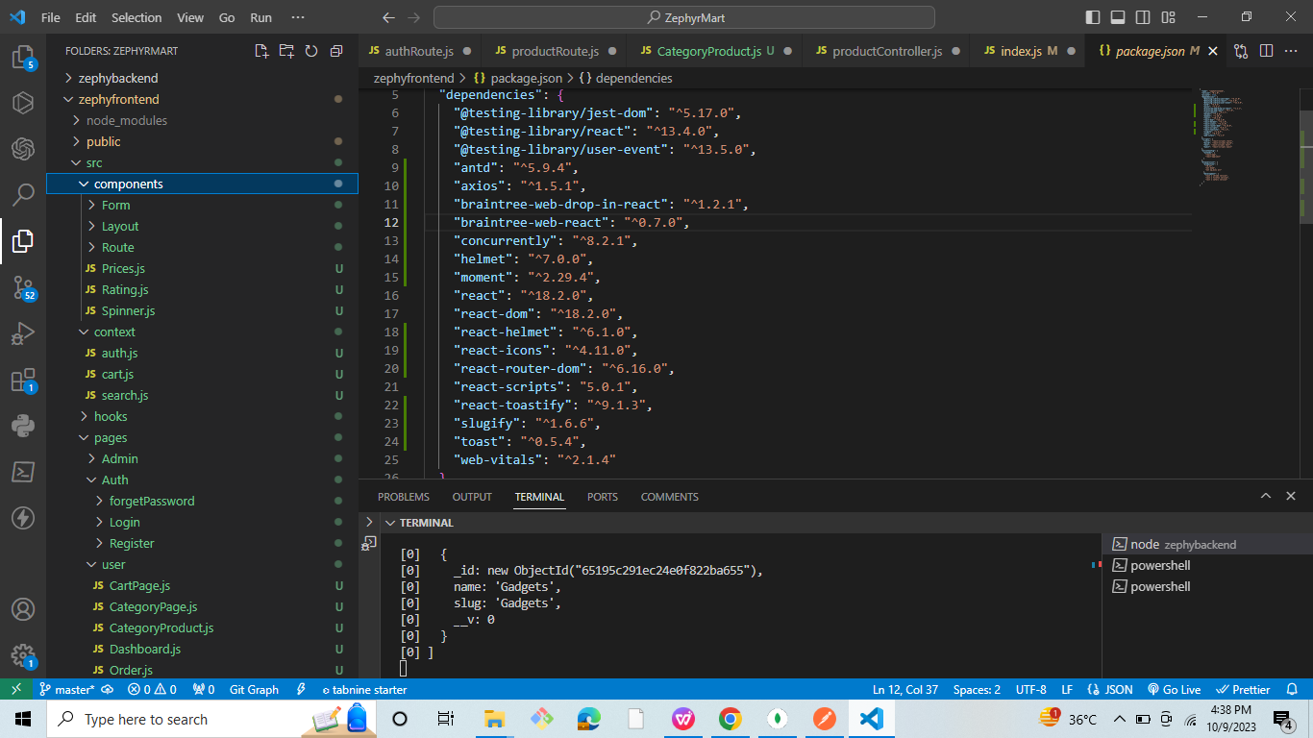
added screenshot of dependencies

Slide 31
components:
1:App.js:
in this component I have define all component s through the react router routes.
src file:
in the src file I have created 5 files.
1 components:
1:form->categoryform.js :
for creating to this component for adding category of the product in the database.

Slide 32
2:Layout:
I have handle header and footer through the layout.
Layout->header.js:
creating headers
Layout->footer.js:
creating footer
Layout->Adminmenu.js:
this compent used in the admin dashboard
Layout->usermenu.js:
this component used in the user dashboard
Layout->Layout.js:
this components is used to wrap header ,body(children)and footer .

Slide 33
3 Route:
Route->private.js:
this component is checked user is authenticated or not if authenticated they can route directly to the user dashboard.
Route->AdminPrivate.js:
this component is checked user is authenticated or not if authenticated they can route directly to the admin dashboard.
4 Prices.js:
in this component I have define all the price for mixture.
5:Rating.js:
I have make rating component .
6:Spinner.js:
spinner is used for when when http take time to fetch the data then here used spinner

Slide 34
2 context file:
in the file I have created global state bywhich we can easily handle state in the all component and use it.
1 auth.js:[auth,setAuth] = useAuth();
in this state i have store user detail and token.
2 cart.js:[cart,setCart] = useCart();
in this state i have store selected product detail.
3 search.js:[search,setSearch] = useSerach();
in this state I have store keyword and result store data on the based of keyword.

Slide 35
3 hooks file:
I have created useCategory.js hooks.
in this hooks I have store all category data of the product from the database.
when I have used it I will applied.

Slide 36
4 Stylecss file:
I have created a stylecss file.
I have store all the style sheet component here.

Slide 37
5 Page file:
in the page file I have making all page components like login,signup,admindashboard,userdashboard,etc
I am explaining all the component one by one.
1 Auth:
in the auth file I have created those component that related to the authentication like
1:Auth->forgetPassword
2:Auth->Login
3:Auth->Register

Slide 38
2 user file:
here I have created those components whose similar to the user like
1:user->cartpage
2:user->categorypage
3:user->categoryproduct
4:user->dashboard
5:user->order
6:user->profile

Slide 39
3 admin file:
here I have store all components related to the admin like
1:admin->admindashboard
2:admin->adminorder
3:admin->createcategory
4:admin->createproduct
5:admin->product
6:admin->updateproduct
7:admin->user.js

Slide 40
after completing all the file I have created 8 more component like
1:About.js
2:Contact.js
3:HomePage.js
4:MoreDetails.js
5:pagenotfound.js
6:policy.js
7:search.js
8:searchBox.js

Slide 41
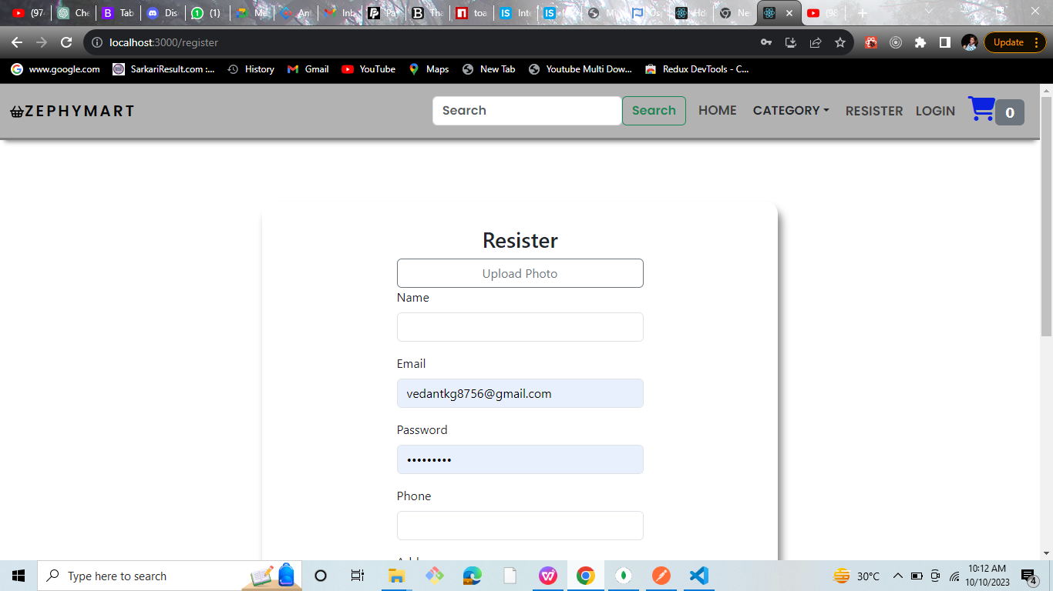
Screenshot of the application: 1 signup page:

Slide 42
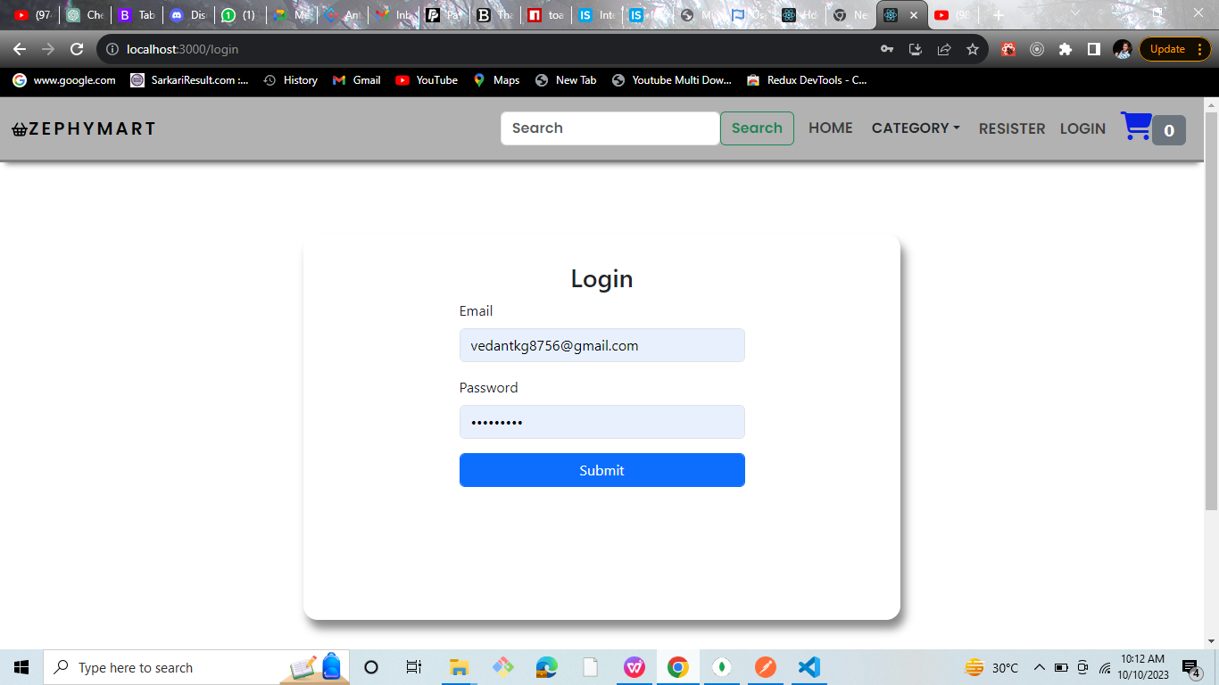
2:login page:

Slide 43
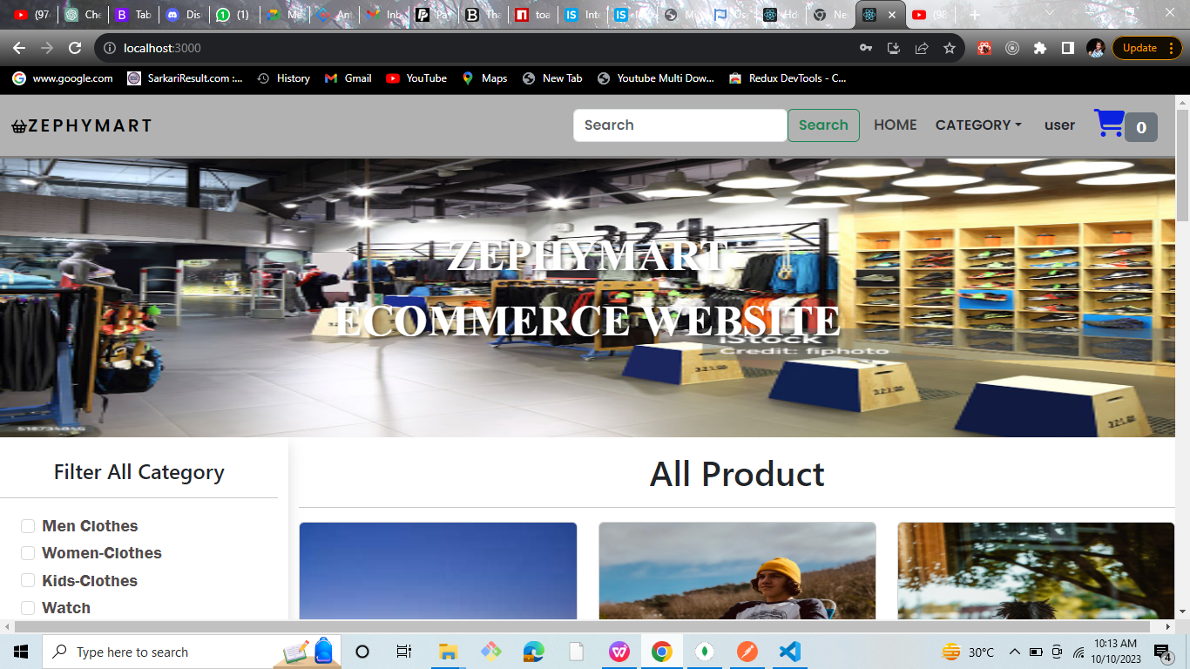
3:homepage

Slide 44
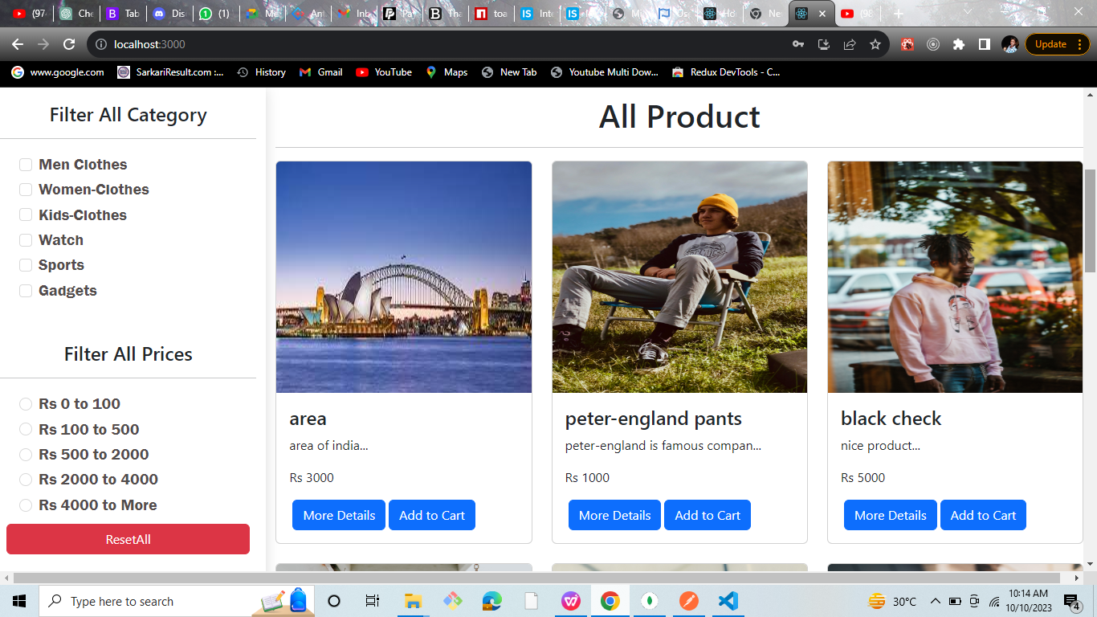
filter category and price

Slide 45
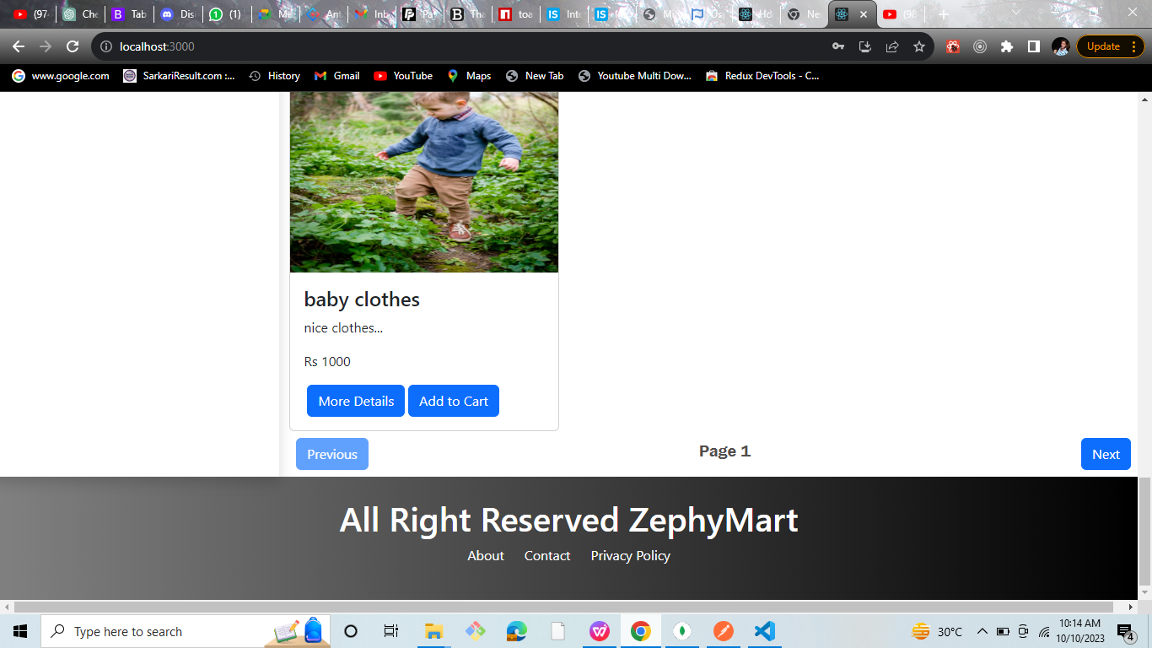
footer

Slide 46
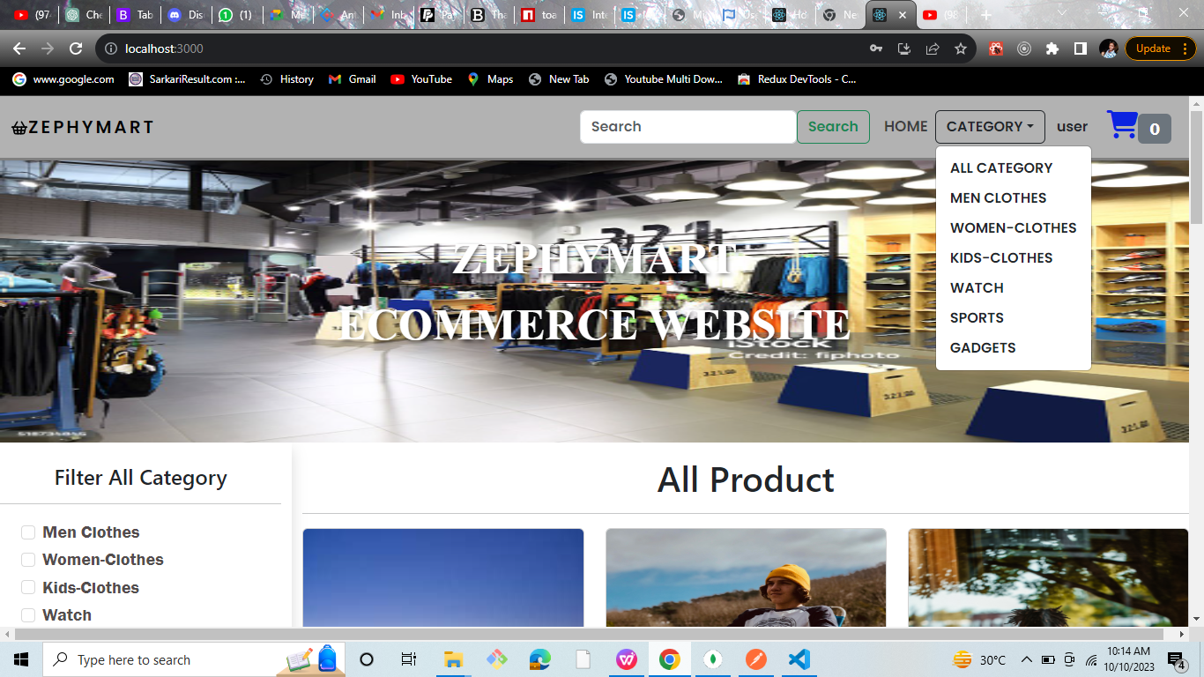
category

Slide 47
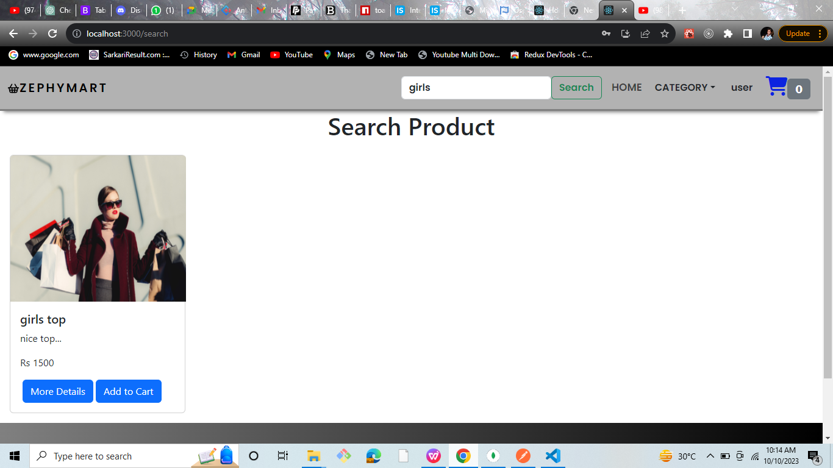
serach box

Slide 48
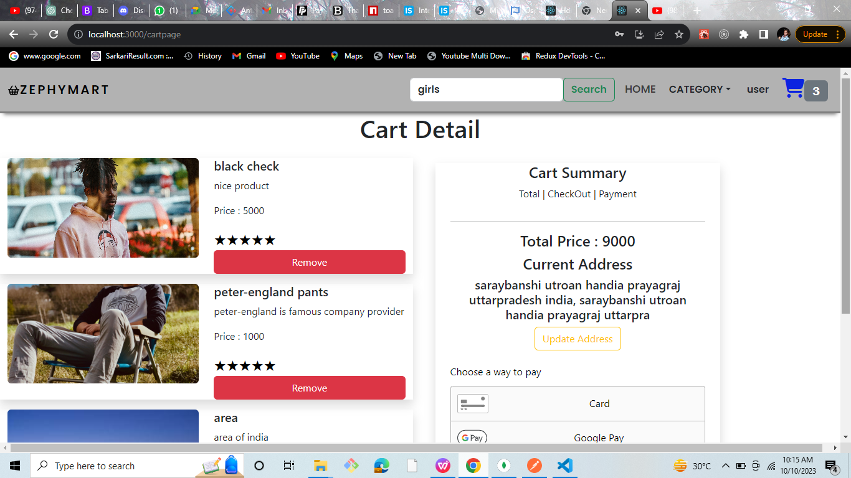
cart

Slide 49
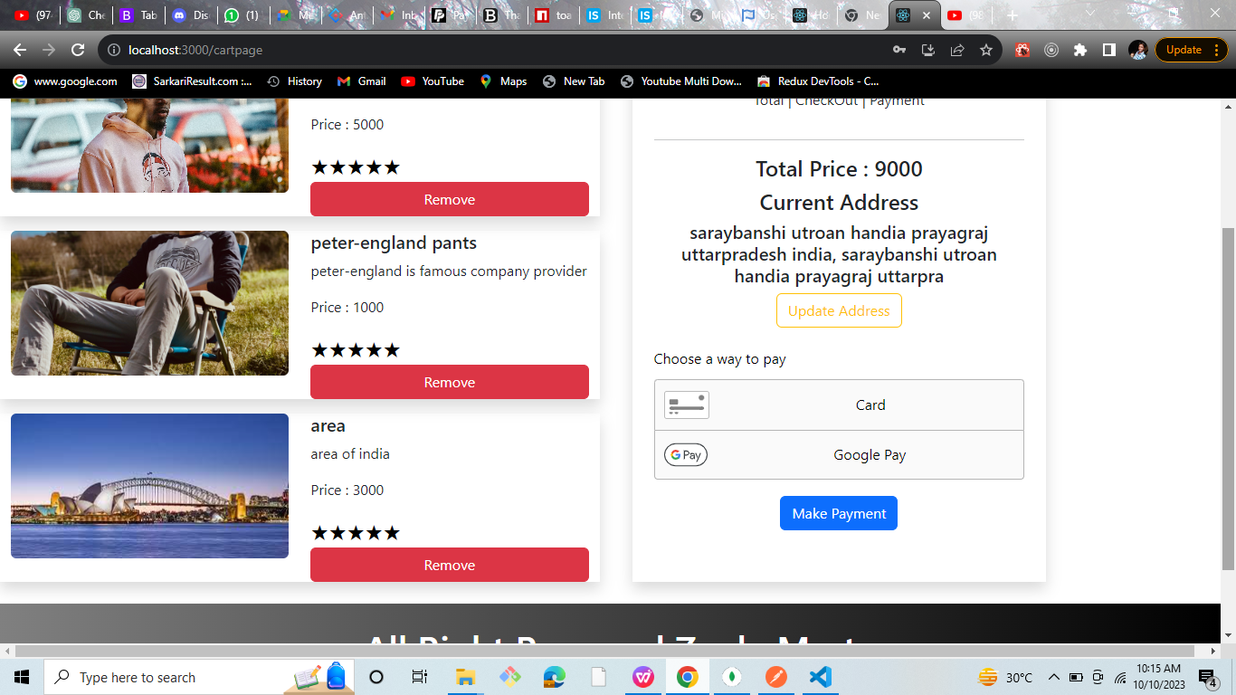
payment gateway(paypal is supported sorry sir)

Slide 50
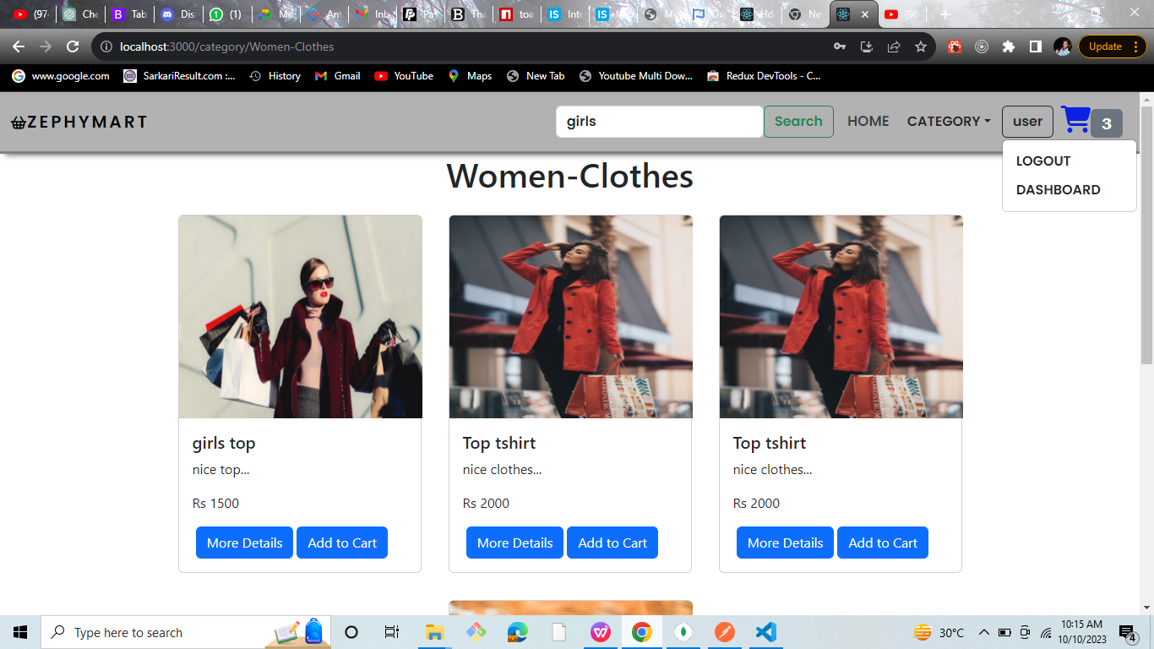
user->dashboard

Slide 51
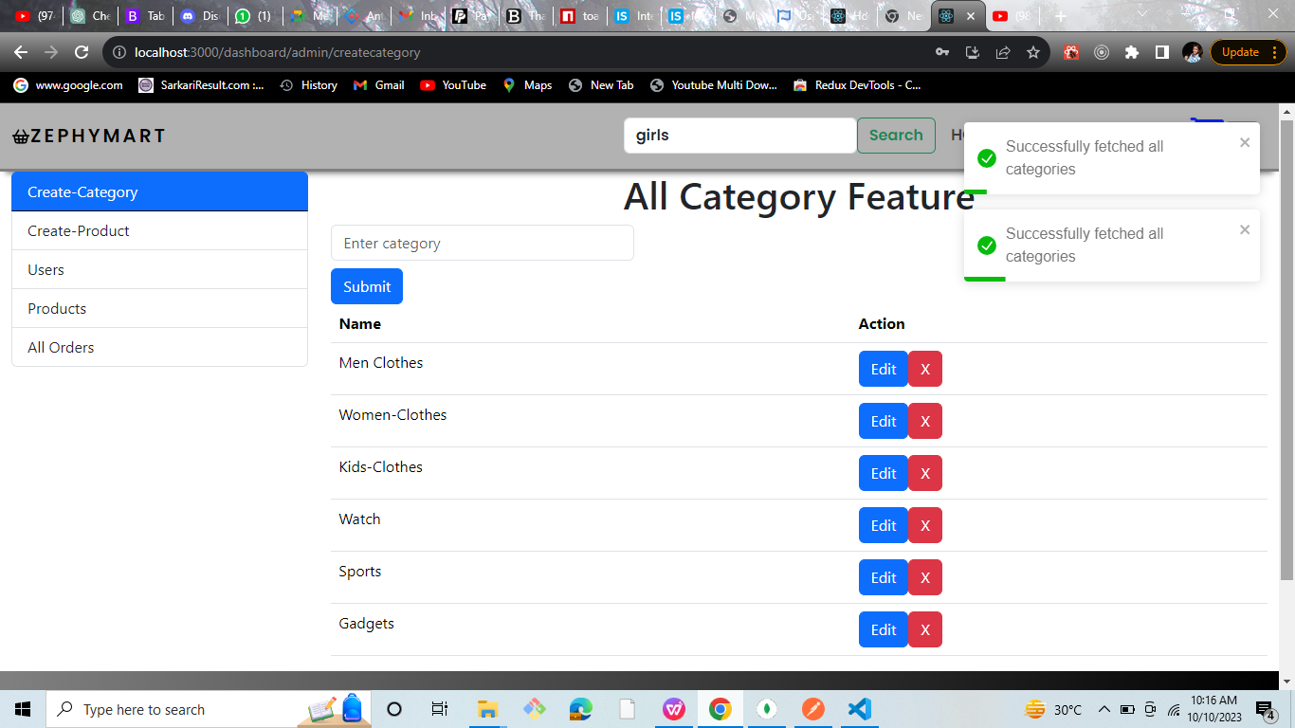
admin->createcategory

Slide 52
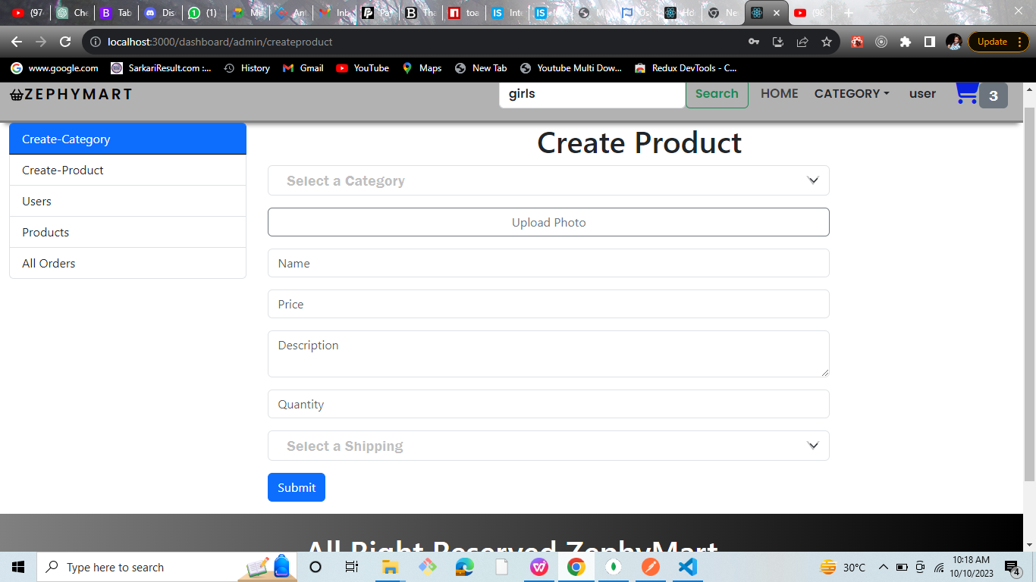
admin->createcategoryproduct

Slide 53
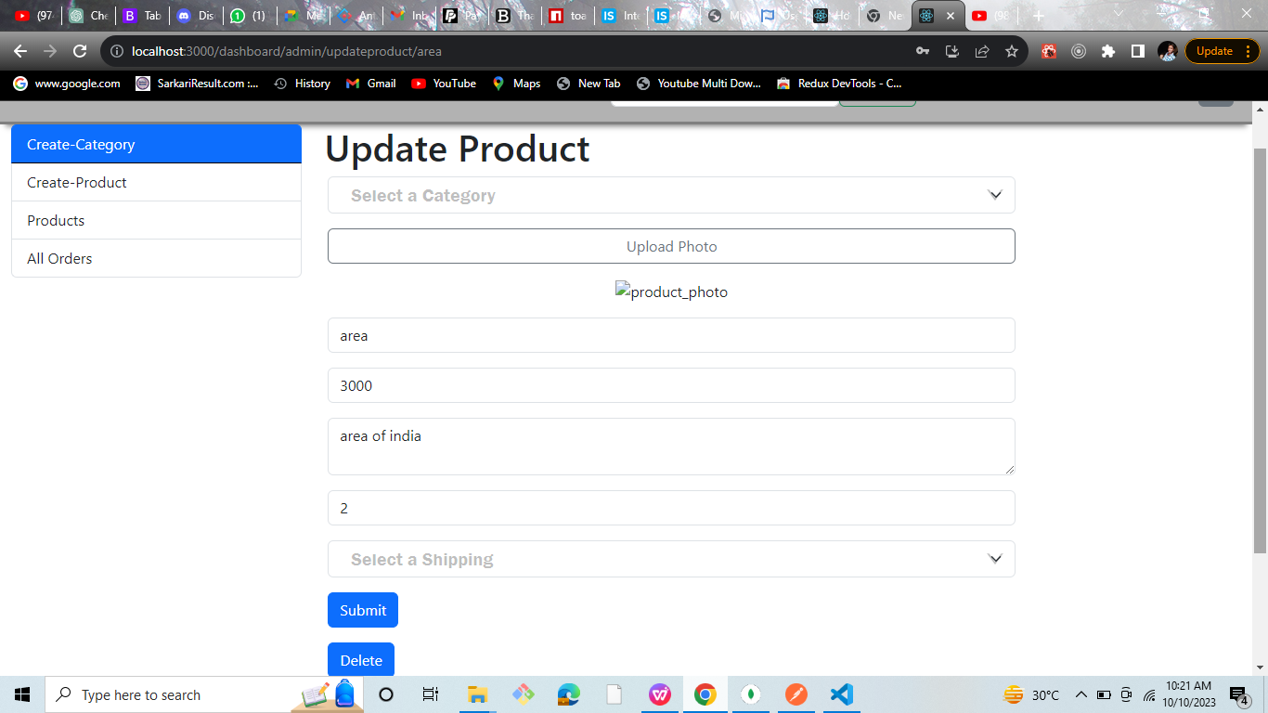
admin->update(when we click in the cart in all product page then directly move to the this update page)

Slide 54
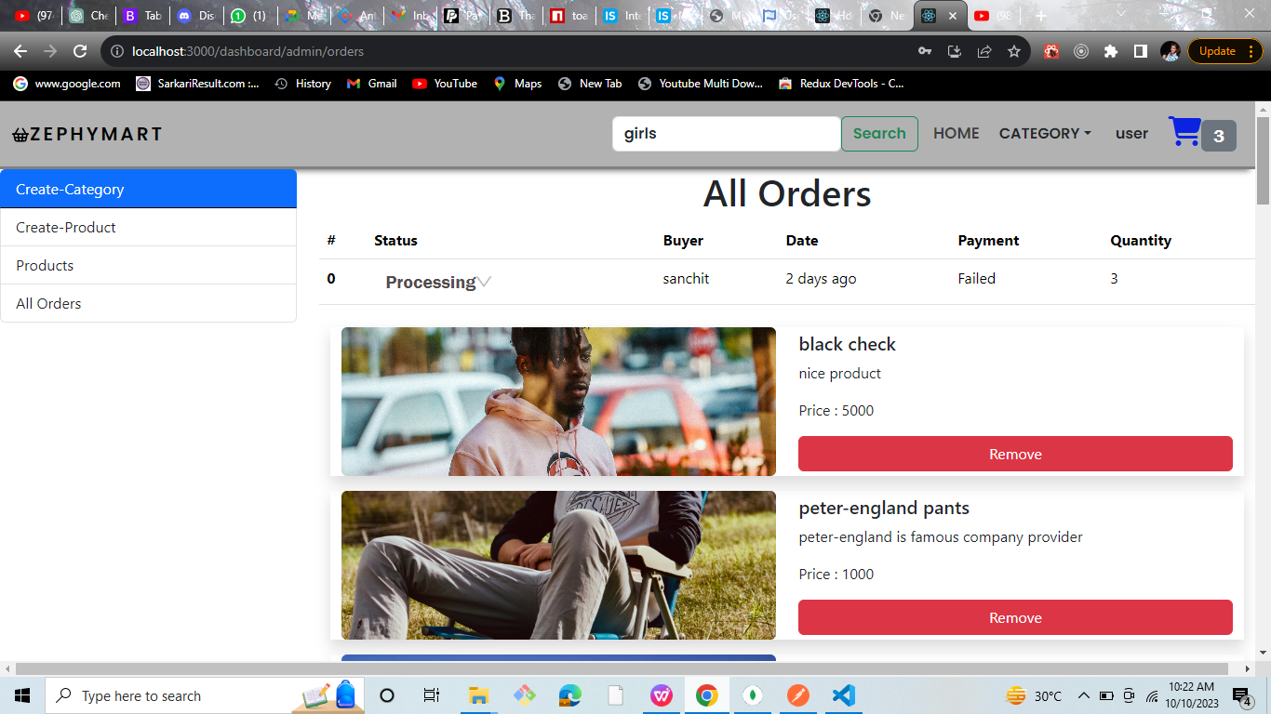
admin all order

Slide 55
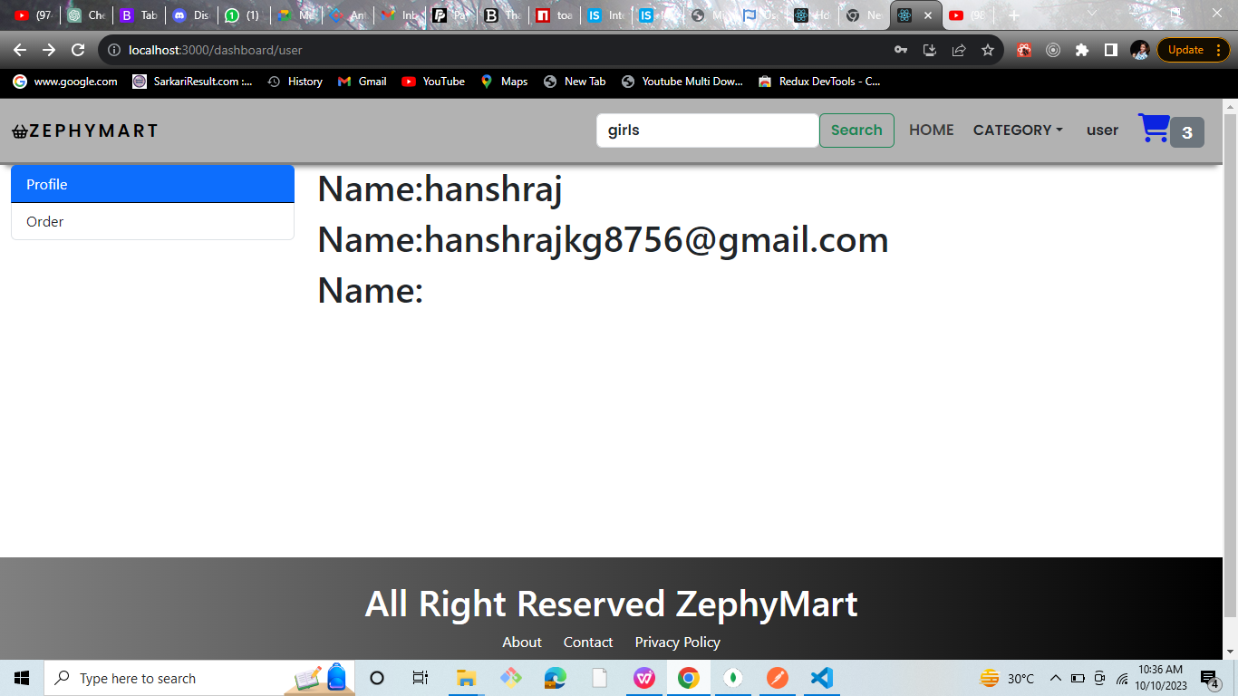
userDashboard

Slide 56
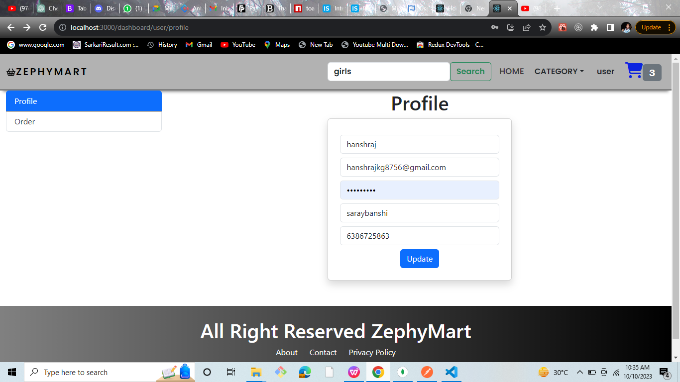
user->profile

Slide 57
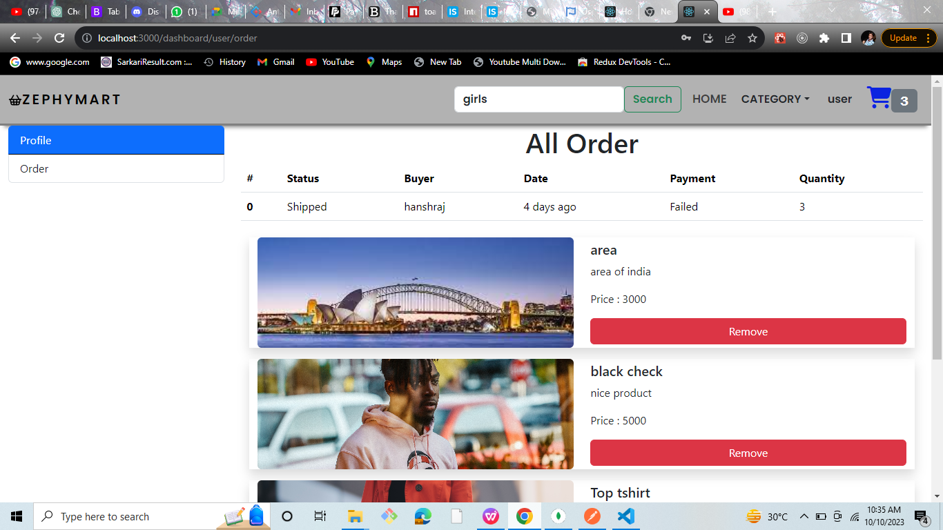
user->order

Slide 58
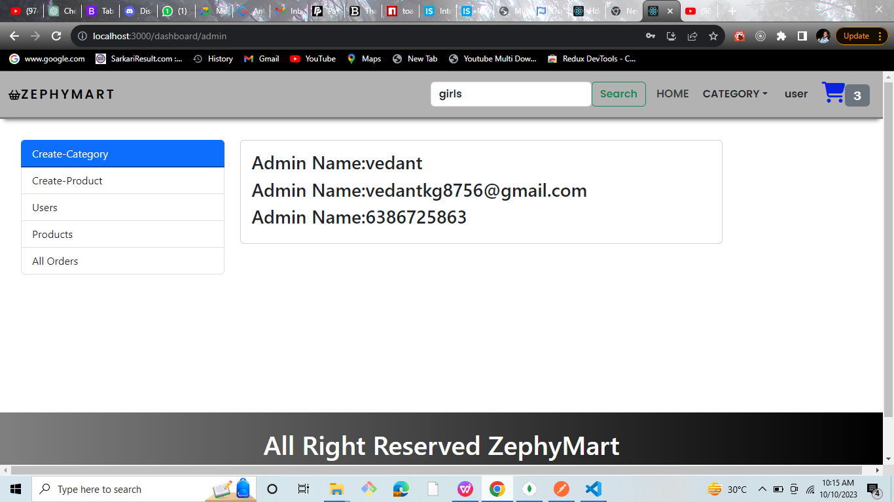
admin-dashbaord

Slide 59
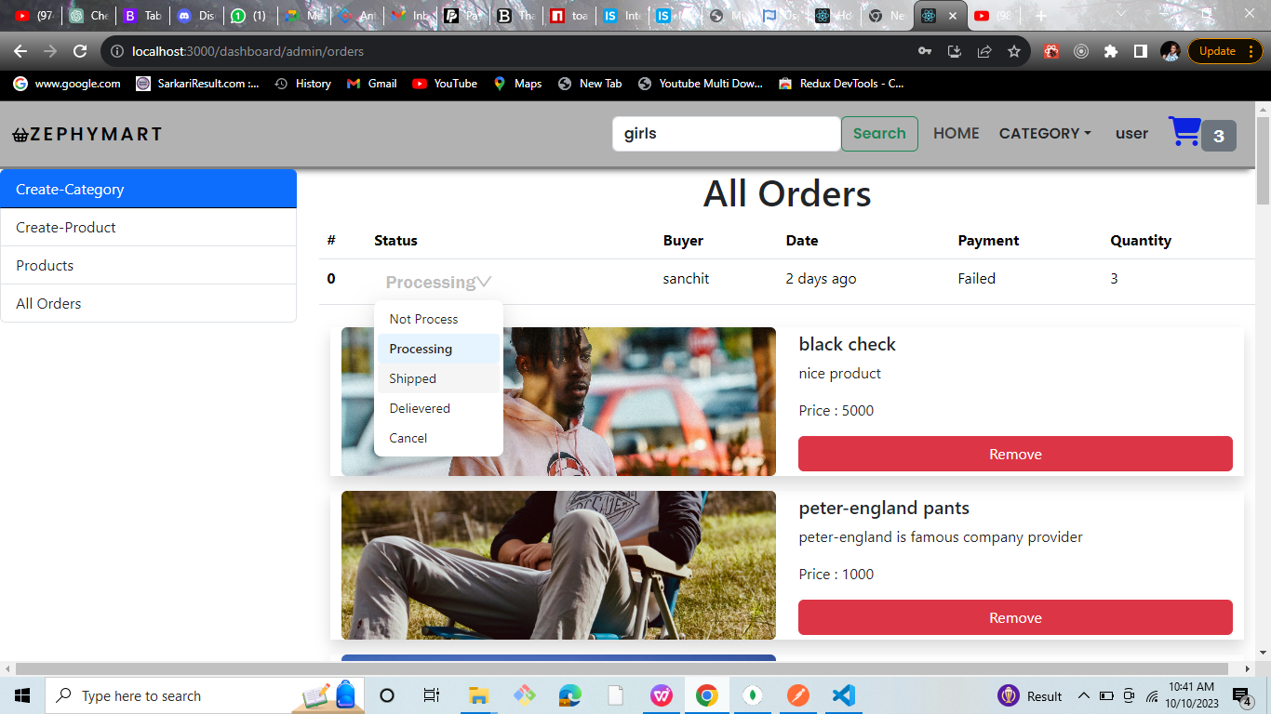
shipping

Slide 60
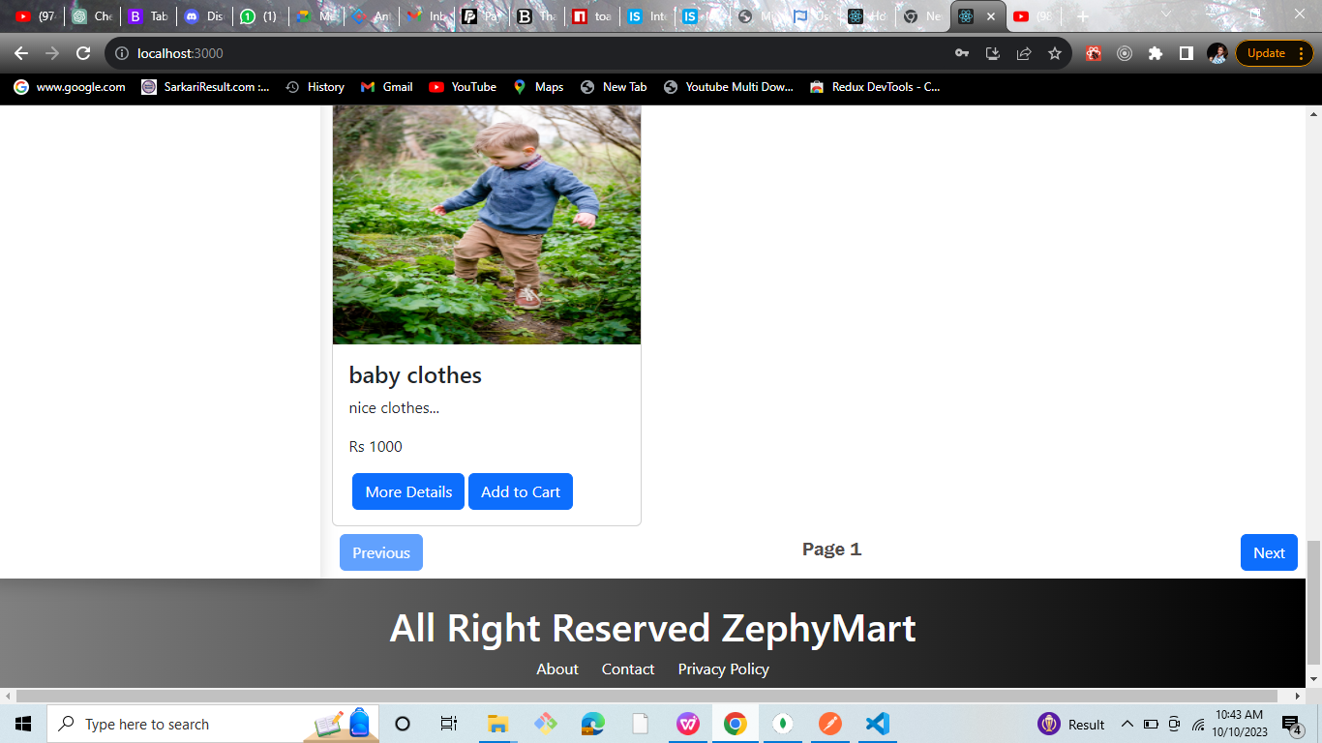
pagination

Slide 61
deployment:
when I try to deploy the application sum warning are occur and I also discuss about the mam but problem is not resolved so told please submit say not cut mark related deployment. the backend deployemnt is proper work but in the backend some error are occur.
backend:
https://zephymartecommerce-hanx.onrender.com

Slide 62
THANK YOU

